Slide 1
Townsend MBTA COMMUNITIES
M.G.L. Ch. 40A Section 3A
ACTION PLAN & COMPLIANCE
Prepared & Presented by Jonathan Vos, Regional Planner, MRPC

Slide 2
Economic Development Bond Bill (Chapter 358 of the Acts of 2020) signed January 2021 Amends Chapter 40A (the Zoning Act), Section 3A to require:
A zoning ordinance or by-law that provides for at least 1 district of reasonable size in which multi-family housing is permitted as of right;
Multi-family housing shall be without age restrictions and shall be suitable for families with children.
District of reasonable size.
Have a minimum gross density of 15 units per acre, subject to any further limitations imposed by section 40 of chapter 131 and title 5 of the state environmental code established pursuant to section 13 of chapter 21A
Background

Slide 3
Requirements for Townsend
Townsend must create (but not build) dense, multifamily zoning to be compliant with Section 3A.
As an Adjacent Small Town, the deadline to be compliant is December 31, 2025.
No requirement for specific location of compliant zone in Townsend.
Must zone for at least 178 multi-family units at a density at 15 units/acre (approximately 12 acres).
The MBTA Communities Zone must be by-right and cannot have restrictions such as being age-restricted housing.
Can use an Overlay Zoning District.
Zoned area does not have to be a singular location.

Slide 4
MBTA Overlay District
Would allow for current uses of existing zoning districts without interference.
Does not prevent additional single-family residences from being built where zoning already exists.
Only allows for denser multi-family housing to be built, without requiring it.
Developer is responsible for building – not the community.
A MBTA Overlay district can allow for mixed-use commercial without requiring it.
Design standards and by-law specifications are up to the community as long as they meet the state mandated requirements.

Slide 5
The three identified overlay zones for a viable MBTA compliant district – each potential district allows for the required number of multi-family units (178) at the mandated density of 15 units per acre.

Slide 6
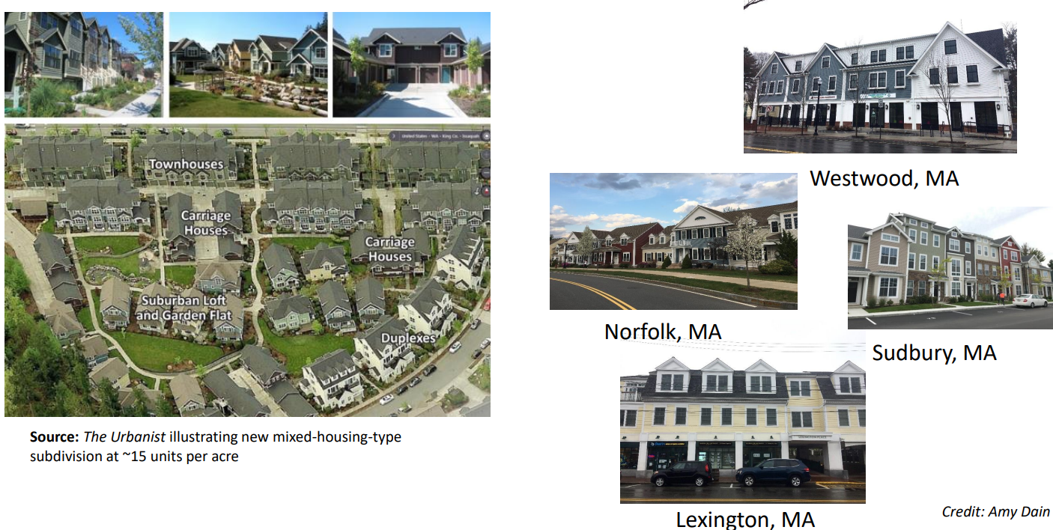
Example dense development (15 Units/acre)

Slide 7
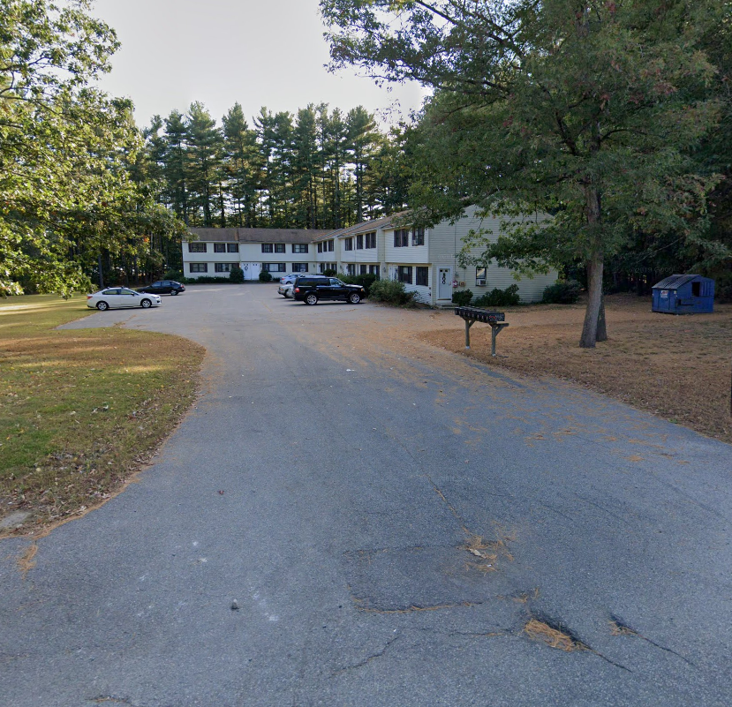
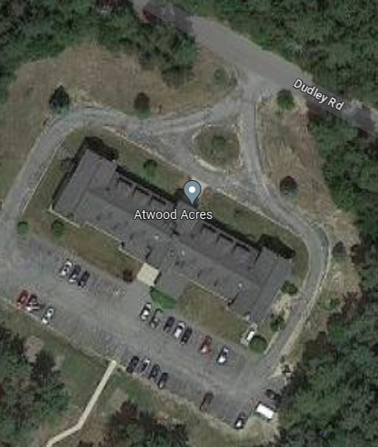
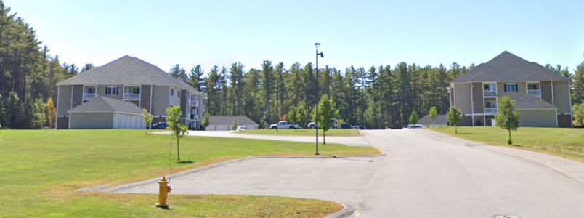
MULTIFAMILY HOUSING IN TOWNSEND
Benjamin Condos, 8 units – 2 acres
Atwood Acres, 50 units – 6.6 acres
Turnpike Village, 48 units – 1&2 bdrm. rentals – 12 acres

Slide 8
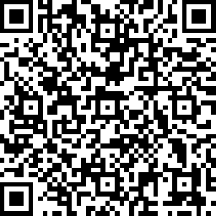
QUESTIONS?
Please use the QR code to access the public survey for providing direct feedback on the three proposed locations for an Overlay District.

